Slide 1
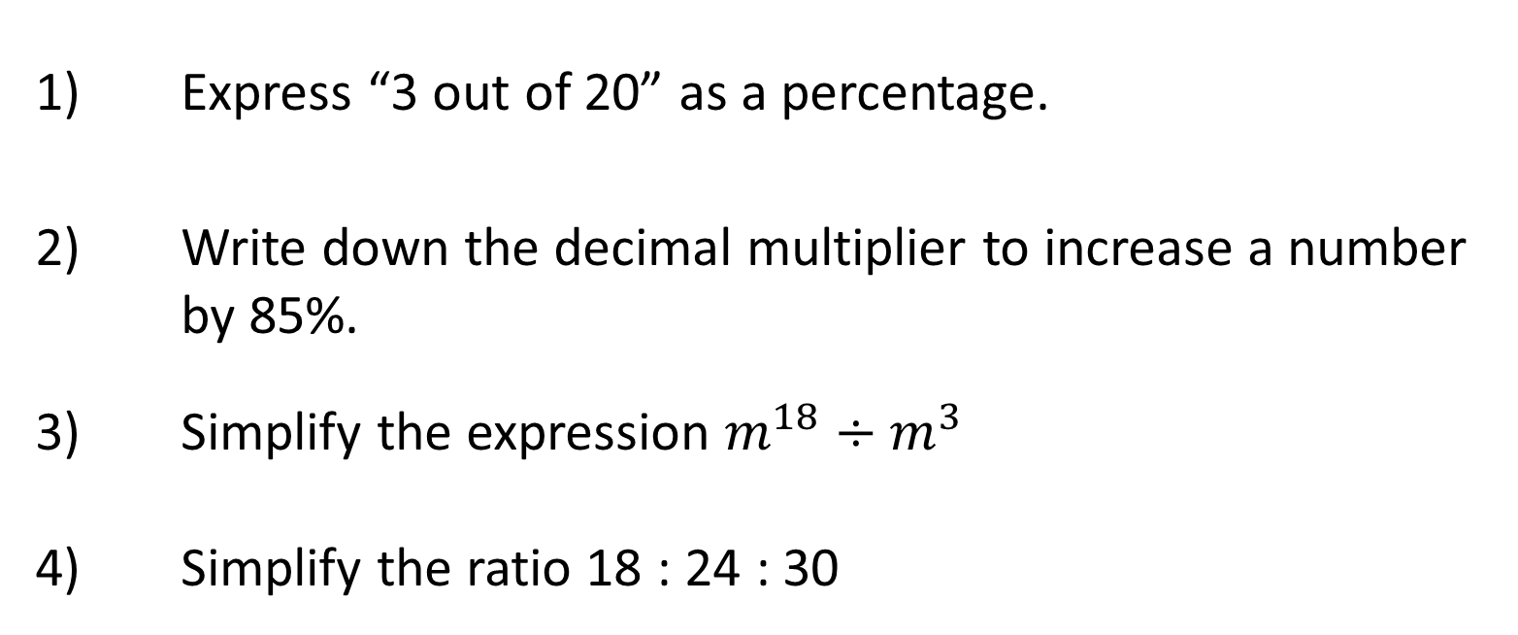
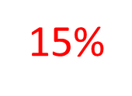
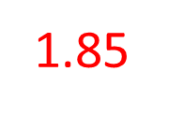
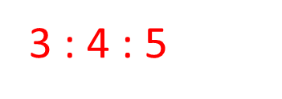
Y8 Spring | Week 9 | Day 1

Slide 2
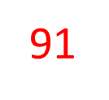
Y8 Spring | Week 9 | Day 2
$$x$$ | – 1 | 0 | 1
$$y=7−x$$

Slide 3
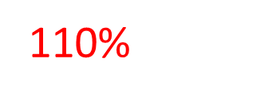
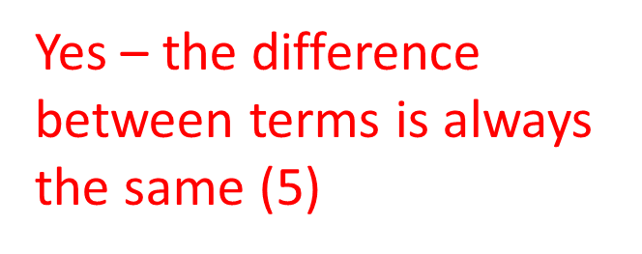
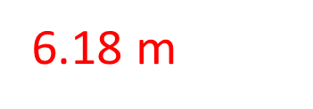
Y8 Spring | Week 9 | Day 3

Slide 4
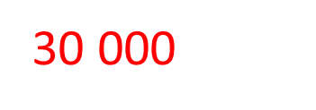
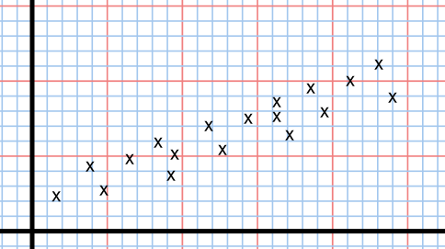
Y8 Spring | Week 9 | Day 4

Slide 5
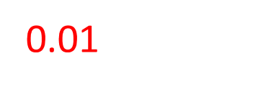
Y8 Spring | Week 9 | Day 5

Slide 6
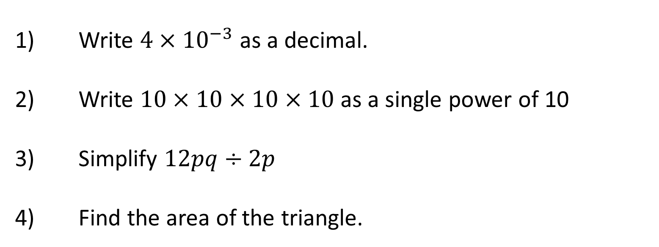
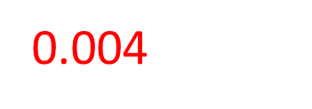
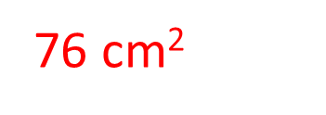
Y8 Spring | Week 10 | Day 1
8 cm
19 cm

Slide 7
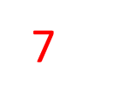
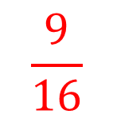
Y8 Spring | Week 10 | Day 2

Slide 8
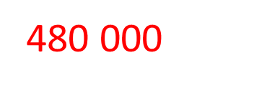
Y8 Spring | Week 10 | Day 3

Slide 9
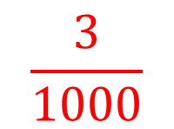
Y8 Spring | Week 10 | Day 4

Slide 10
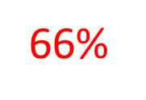
Y8 Spring | Week 10 | Day 5

